Slide 1
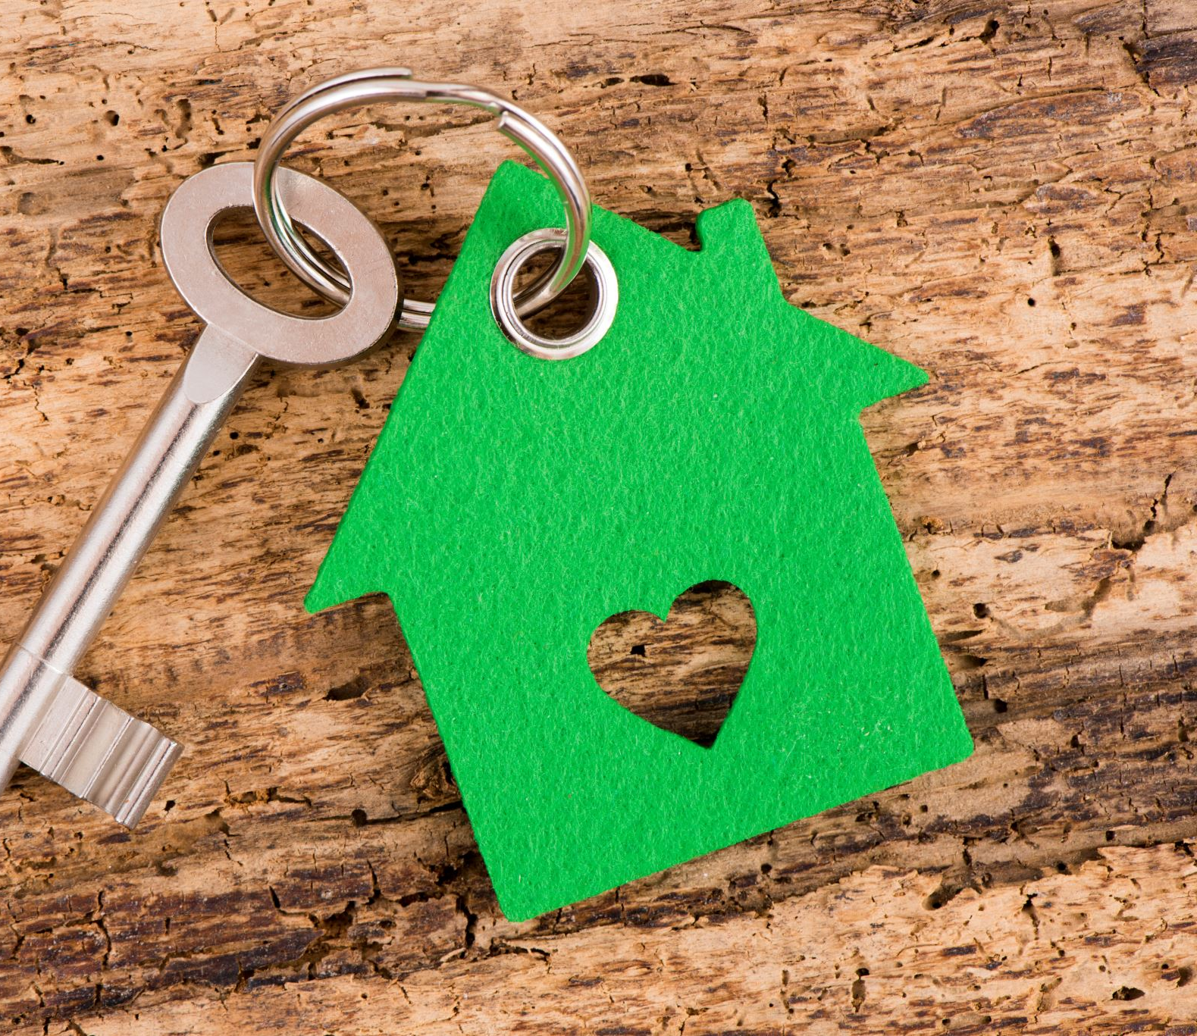
Diane and
John Burke
Passive House in Middletown NJ
10/18/2021
Sierra Club Shore Group
Science Monday

Slide 2
Passive House Goals
Net zero energy usage
Zero Carbon footprint
Minimize waste in Construction

Slide 3
Our Reasons For Building Passive Prefab
Climate Change – The gratification of living with minimal or no carbon footprint
Ambience of the home – Both the climate and quiet
Social Responsibility - To be part of the systemic changes needed for Climate change
There is a lot of flexibility with the look and size of the house
Prefab factories maintain dry and clean environments
Prefab construction generates less waste and much of the waste is recycled, for instance used for biomass.
Prefab has consistent quality
Insulation is made from cellulose, a nontoxic substance and environmentally friendly
Prefab reduces the energy in the built environment by 80% or more
Cost is $250-450/square foot versus regular house about $300/sf

Slide 4
MAJOR OBSTICLES FOR OUR BUILDING
Finding a property was the biggest obstacle. We wanted a crummy house on a beautiful property with enough land for a large organic garden.
Finding the right Prefab Passive House companies.
Obtaining a variance with the town so that we can live in the old dwelling while we build the new Passive House.
We have yet to see how easy Middletown will be for this project as we are only about to submit the blueprints, survey and site plan

Slide 5
Attaining Passive House Goals
THE KEY ELEMENTS WITH INTELLIGENT DESIGN
  Minimize Thermal Bridges
  Super insulated and air-tight Building Envelope
  18” thick exterior walls
  Energy Recovery Ventilation (ERV)
  High efficiency Heat Pump
  Superior air-tight triple pane window assemblies
  Low Energy Consuming Lights & Appliances

Slide 6
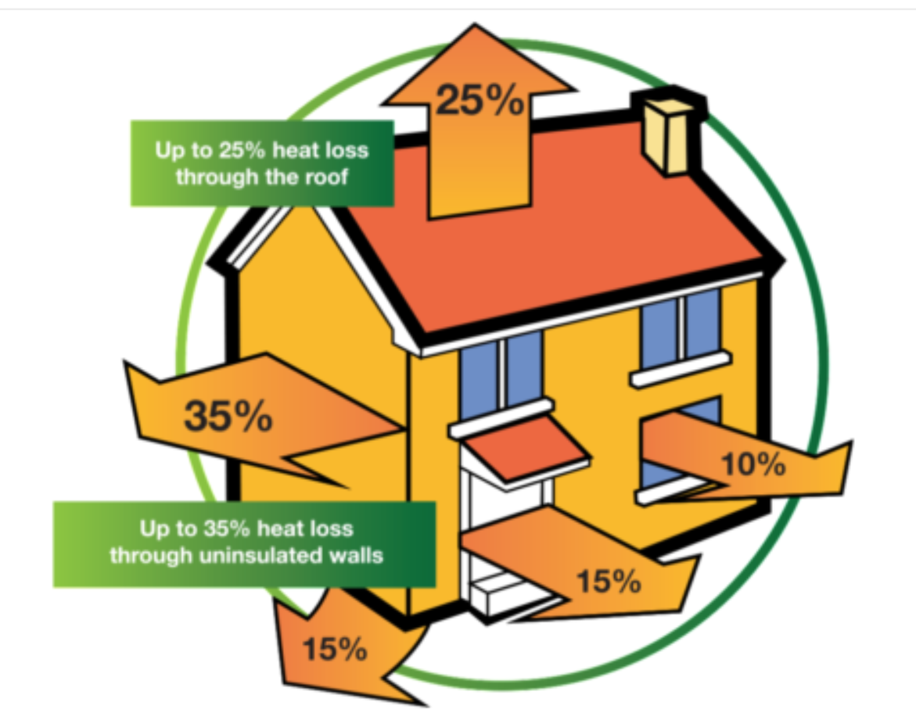
Minimize Thermal Bridges
Thermal Bridge - Heat makes its way from hot to cold following a path of least resistance causing heat loss, condensation, and requiring additional energy to mitigate.
Controlled air flow
No cold and damp spots
Less effort to calculate the heat energy balance
Thermal bridge losses are less than the limit value (set at .01 (W/(mK)).
Heat energy is saved

Slide 7
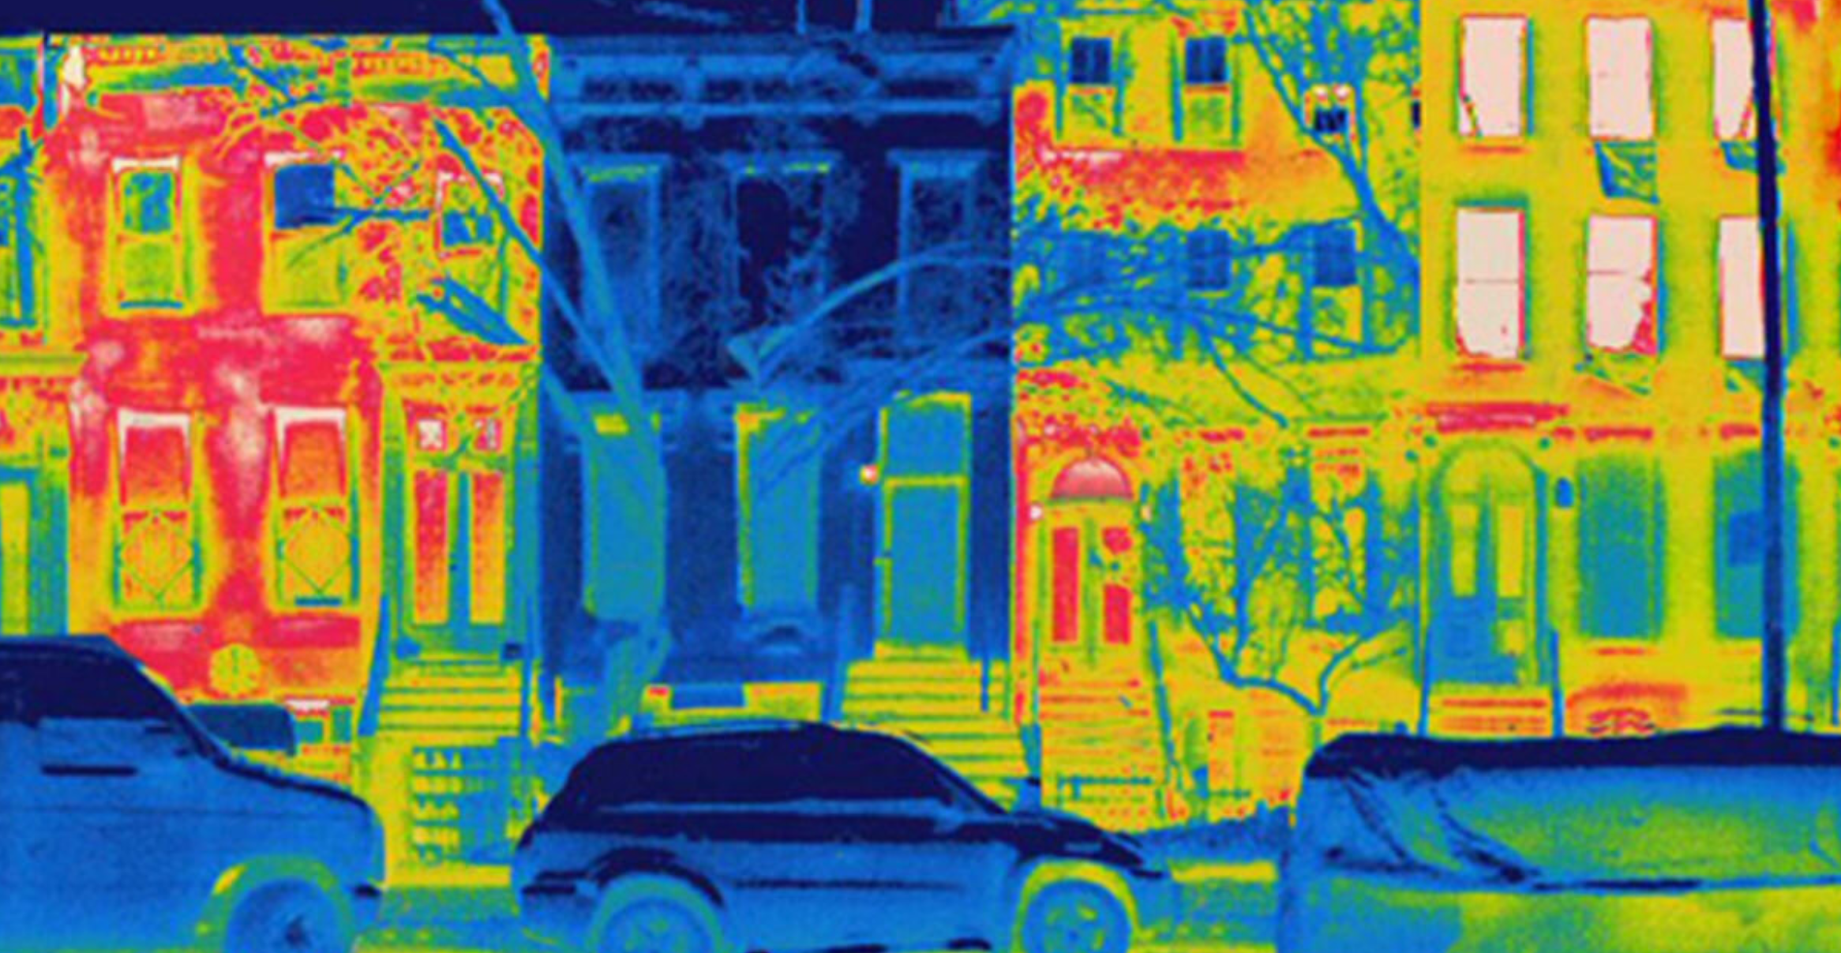
Thermal Imaging shows the temperature of each surface.
Guess which one is the Passive House?

Slide 8
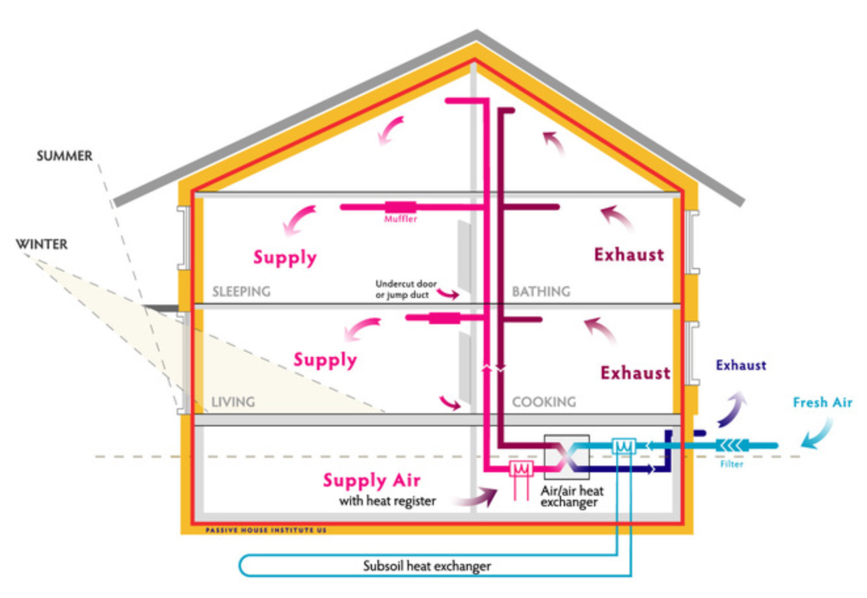
Building Envelope
Separates the interior from the exterior
Continuous extra thick insulating envelope all around the building (yellow lines).
Complete airtight layer (red lines)
Thick insulated exterior walls – 18”

Slide 9
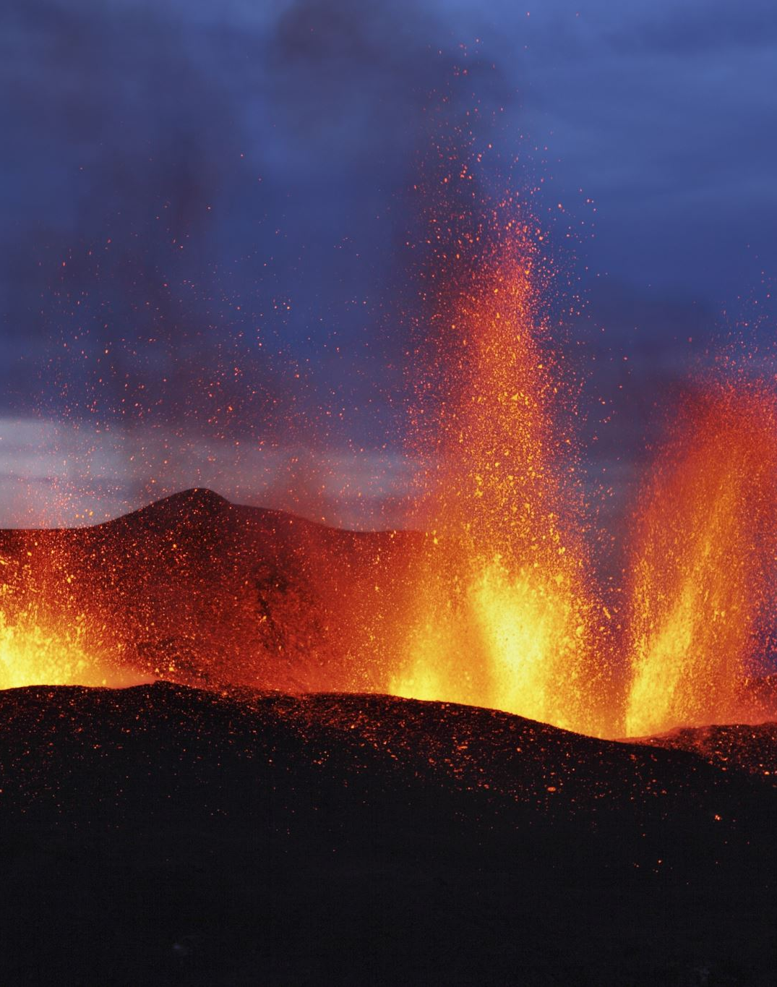
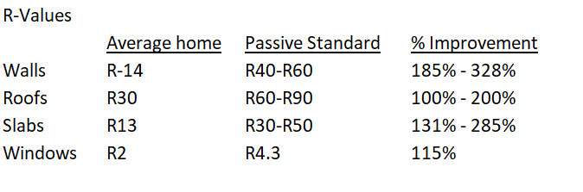
Thermal Resistance – R-Values
Thermal Resistance is the ability of a material or structure to resist heat transfer
Higher is better

Slide 10
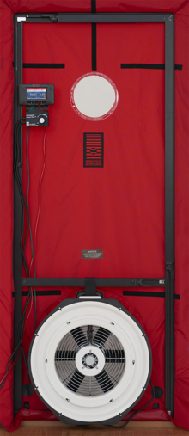
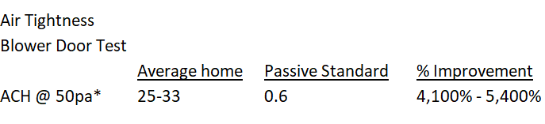
“Blower Door Test”
Airtightness is measured by a “Blower Door Test”
Passive House Standard: < 0.6 ACH @ 50pa
  ACH = Air Changes per Hour
  50pa = 50 Pascals pressure (about 0.007 psi)

Slide 11
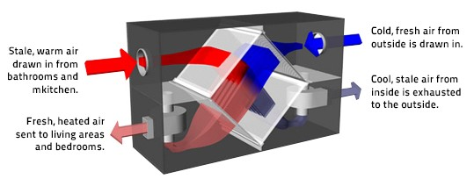
Energy Recovery Ventilation (ERV)
The ERV serves as the Heating, cooling, and Ventilation system of the house.
Reduces the energy required to bring outside air up or down to the ambient room temperature, saving money and energy.
In Winter, the ERV extracts the internal humidity and heat from the stale air and transfers it to the incoming fresh (dry) cool air to maintain ambient internal temperature and humidity levels.
In Summer, ERV transfer reverses. The humidity and heat in the fresh outside air is removed before it is transferred into the home to maintain ambient internal temperature and humidity levels.
The stale air and incoming fresh air never mix, they pass in separate channels in the ventilator core heat exchanger allowing an exchange of heat through conduction either heating or cooling the house.

Slide 12
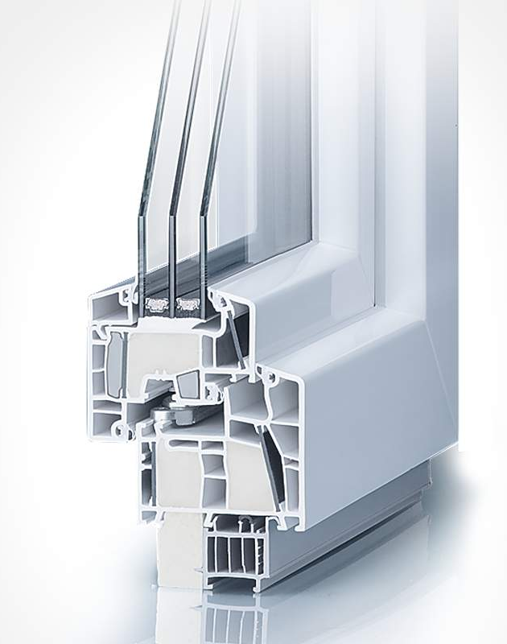
Windows
Triple pane windows
Exceptional thermal and acoustic insulation
Tilt and turn operation

Slide 13
Goals For Our Design
Expect this home being our dwelling as we age
  Master bedroom downstairs to accommodate elderly or disabled
  Laundry downstairs with dog wash tub
  Many windows for natural light and to connect to outside
  Open space creates a feeling of togetherness, activities flow seamlessly through rooms
  Open large den upstairs for spacious office and exercise room together
  Induction stove
Maximize Solar Gain
  Solar panels on roof
  Battery storage with 3-day backup
  Charger for EV cars

Slide 14
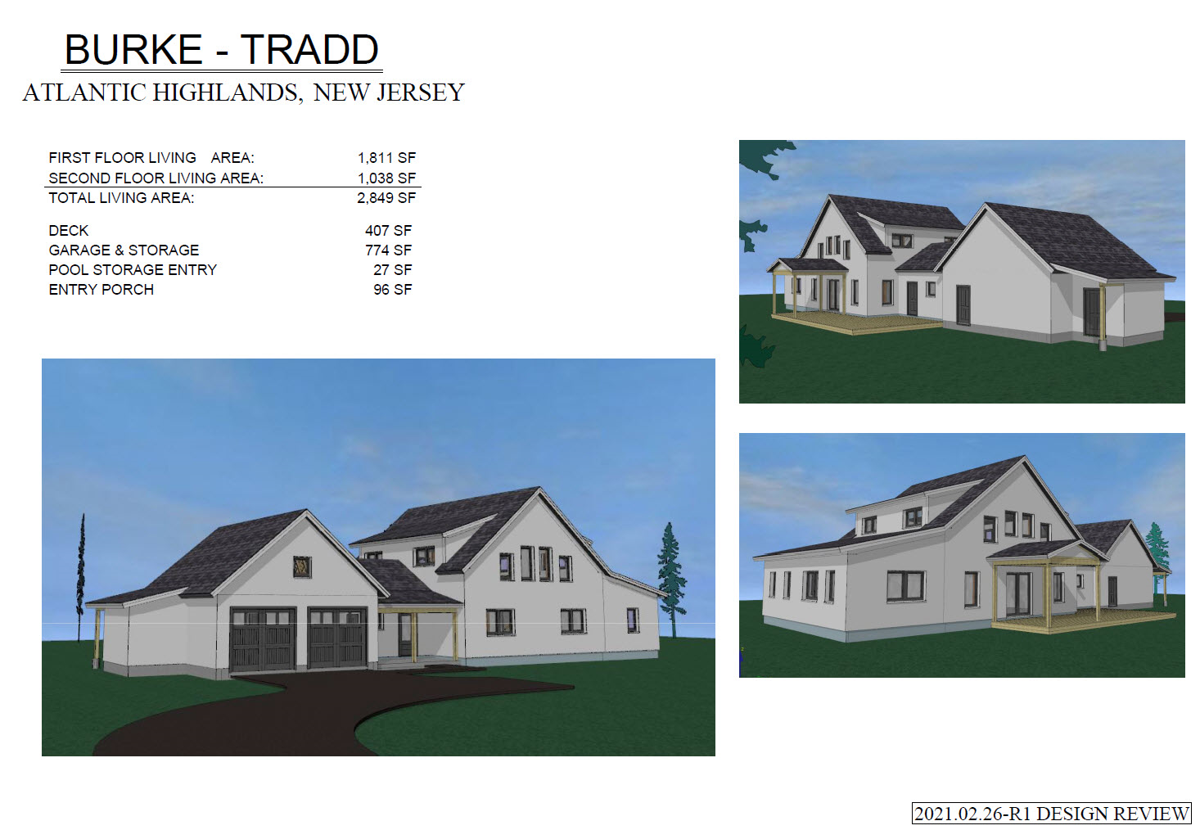
Our UNITY house Design

Slide 15
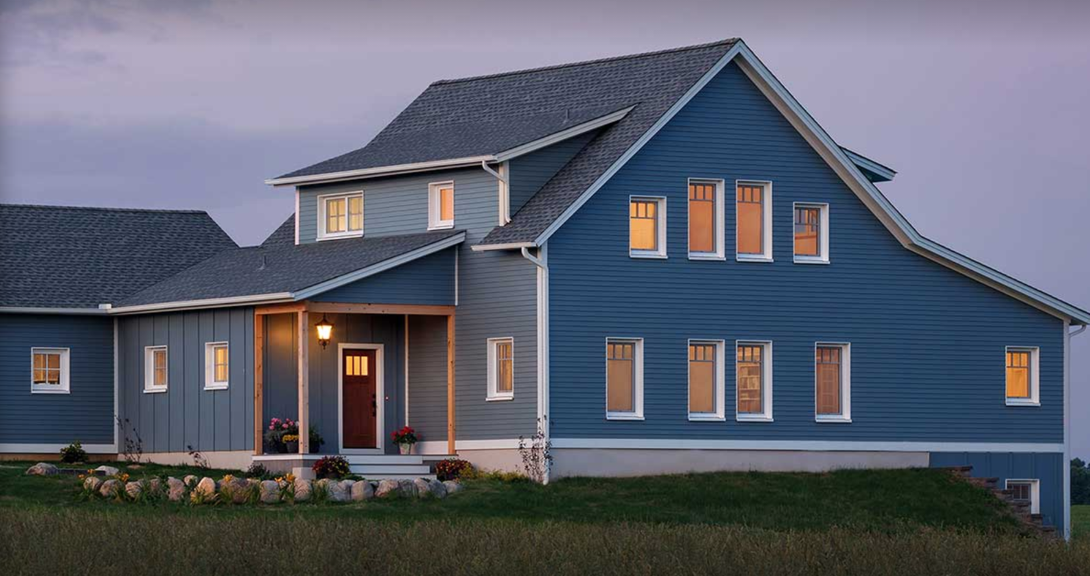

Slide 16
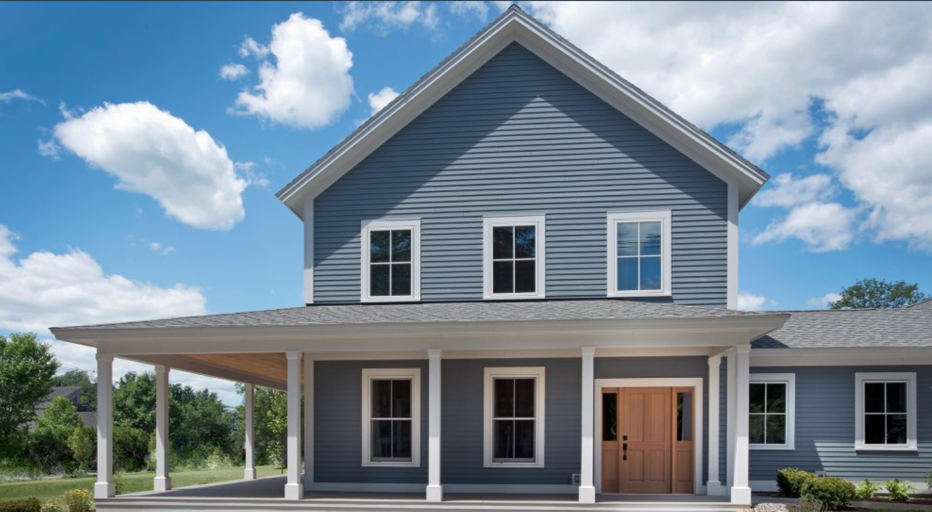

Slide 17
Organic Restorative Agriculture Garden
Agriculture is a big part of Climate Change. We plan to do our best to grow our own food.
We plan to have sheep and goats for tilling and manure to build up the land and use for the garden
Bees and 5 acres of Dutch White Clover for their food. Clover offers nitrogen to lawns also.
Plan on Water harvesting off of our roof into an underground cistern

Slide 18
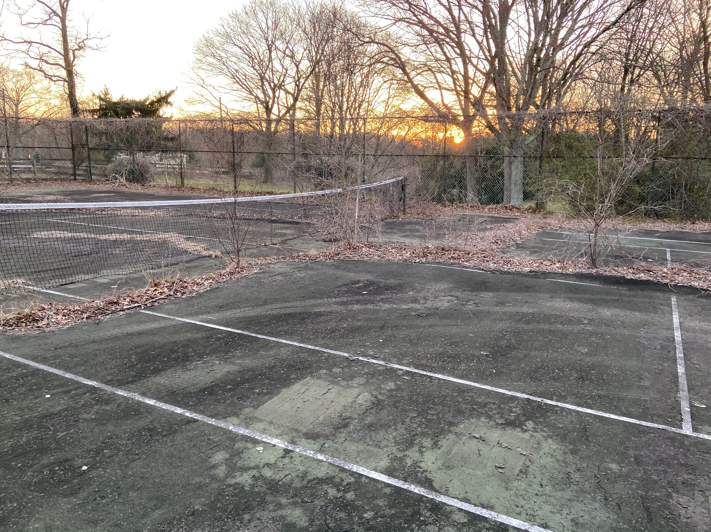
DILLAPIDATED TENNIS COURT CONVERTED TO AN ORGANIC GARDEN

Slide 19
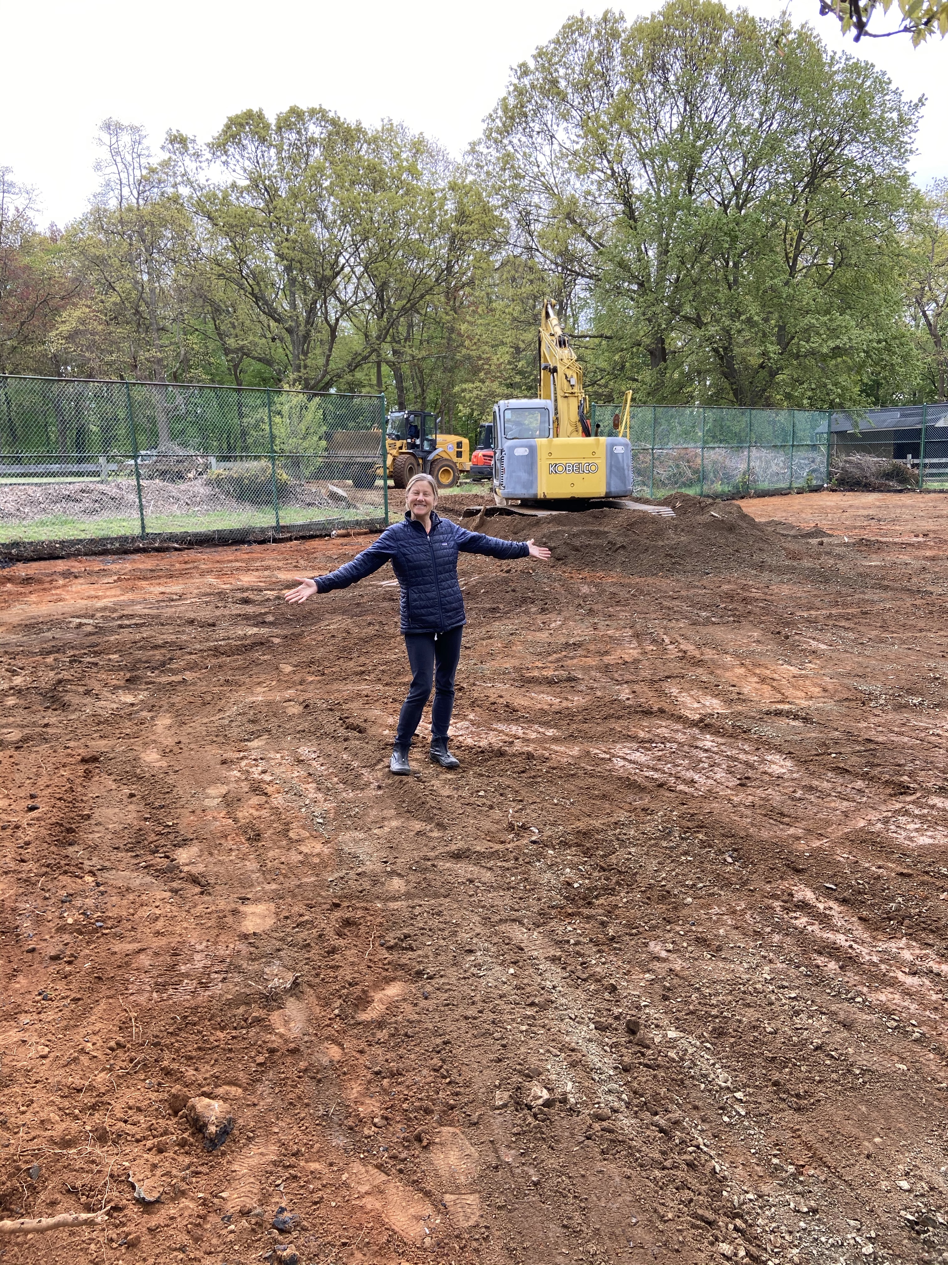
EXCAVATOR REMOVED ALL THE ASPHALT
READY FOR MULCH

Slide 20
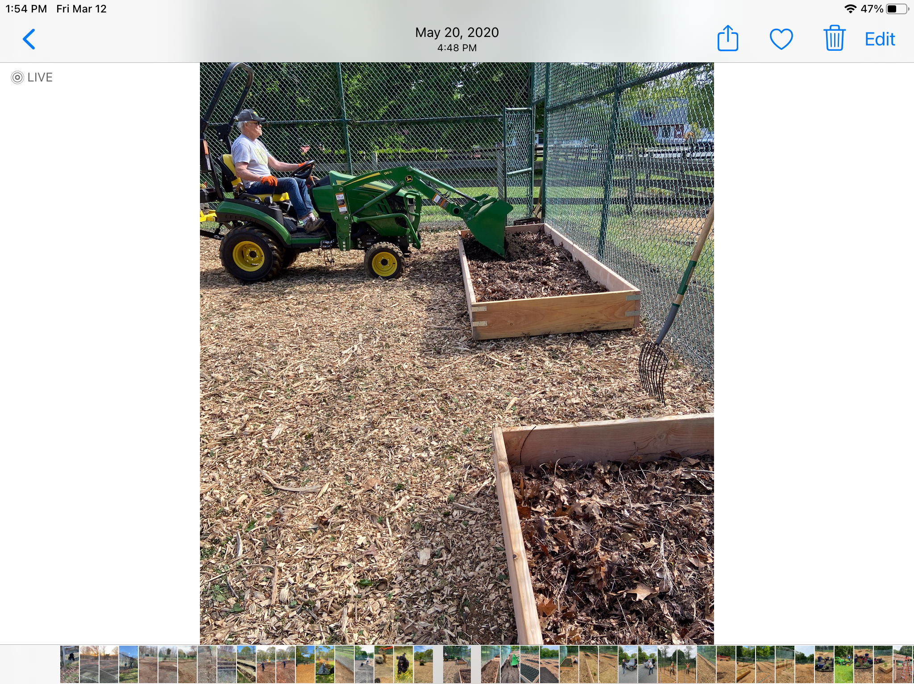
FILLED RAISED BEDS WITH HALF DEAD LEAVES AND HALF TOPSOIL AND COMPOST

Slide 21
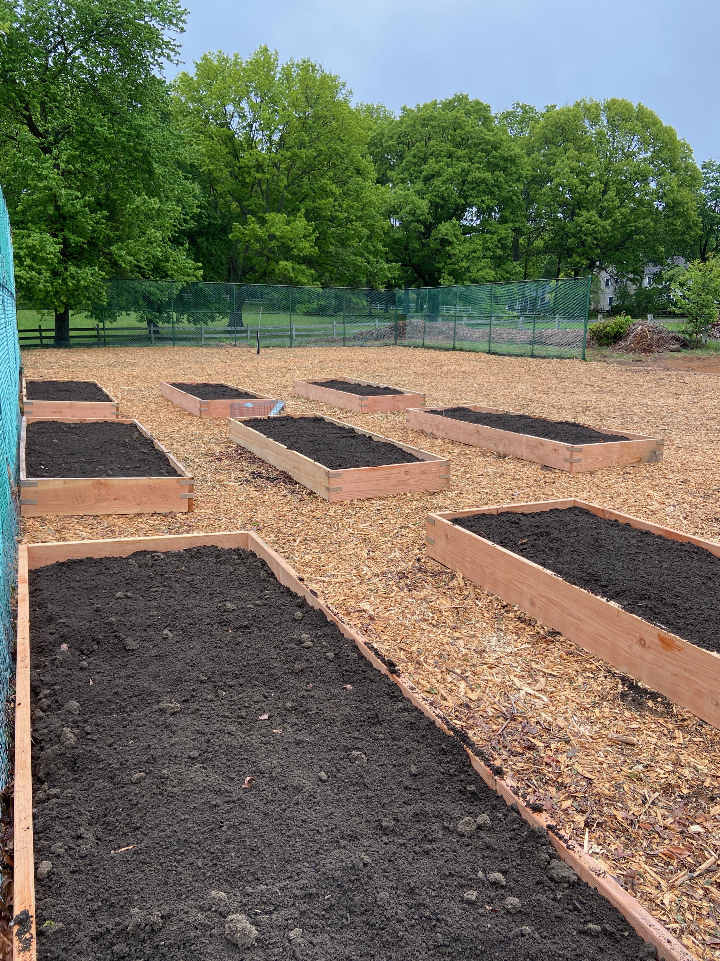
WE BUILT 18 RAISED BEDS -

Slide 22
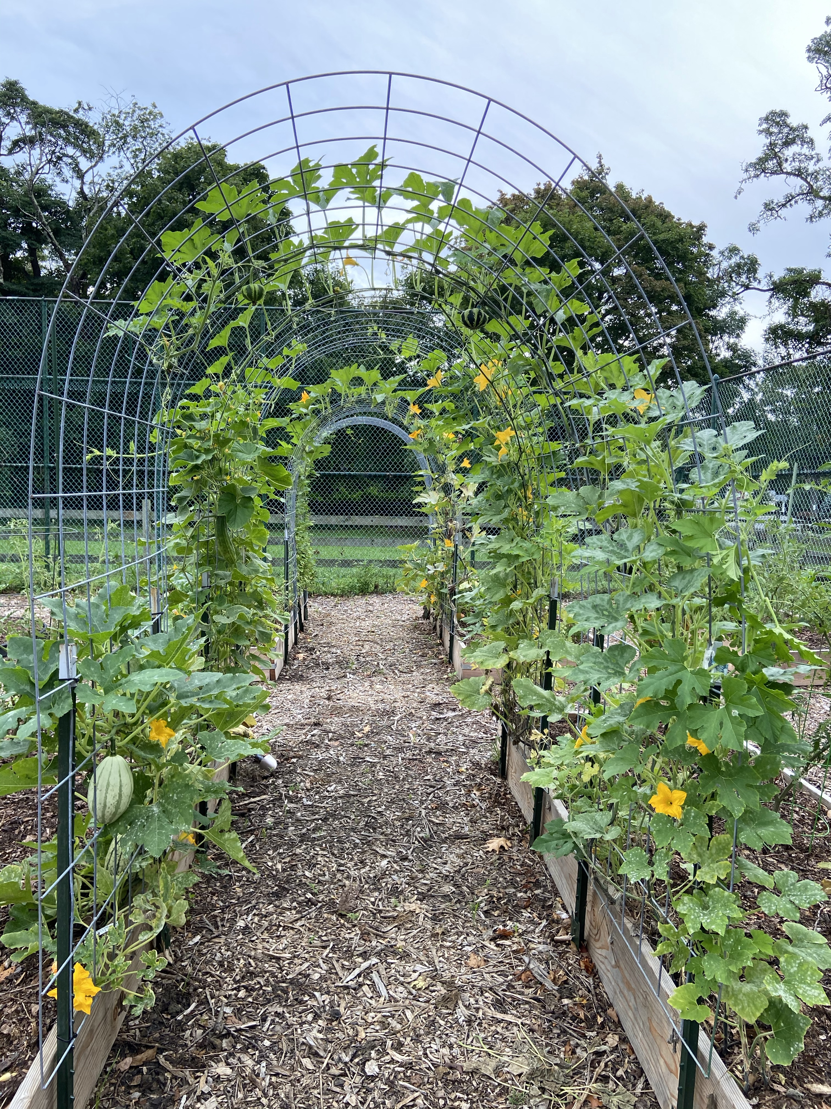
ABUNDANCE NOW GROWS WHERE THERE WAS NO LIFE, FOOD, INSECTS, AND BIRDS

Slide 23
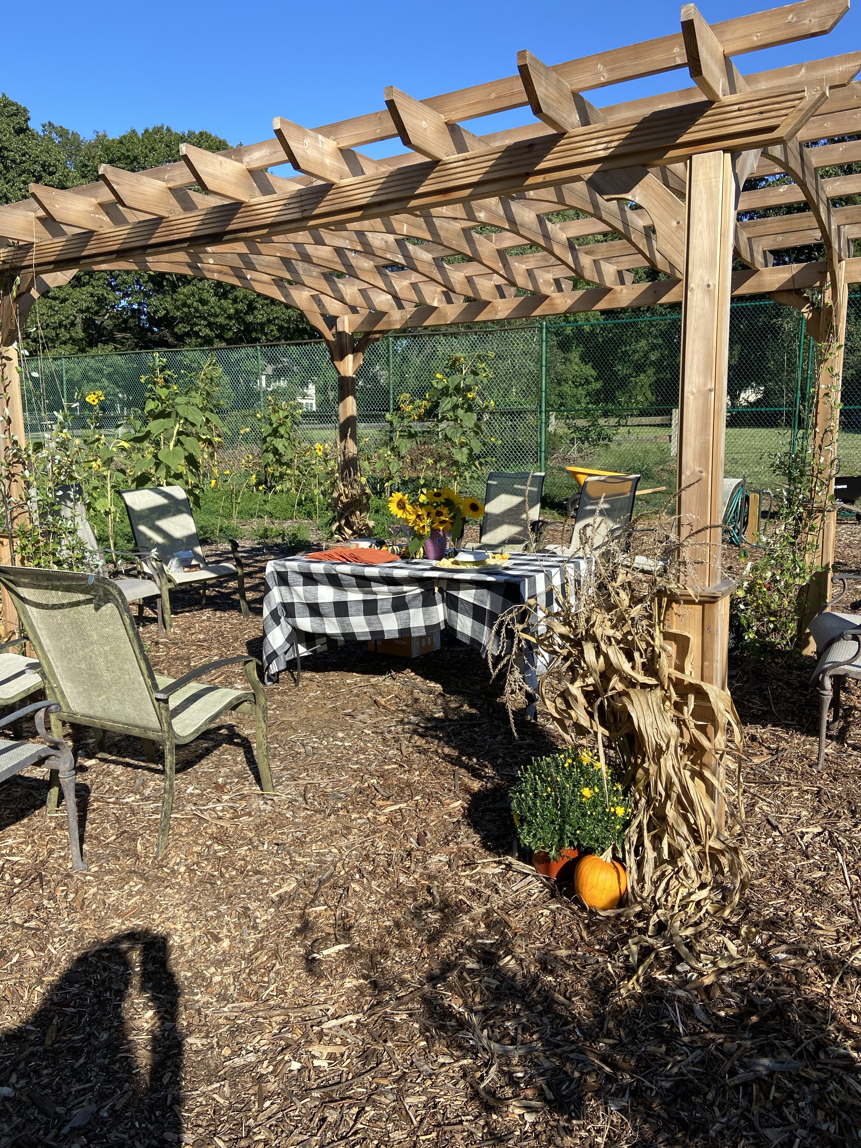
WE BUILT A PERGULA AND LANDSCAPED FOR BEAUTIFUL FARM TO TABLE MEALS

Slide 24
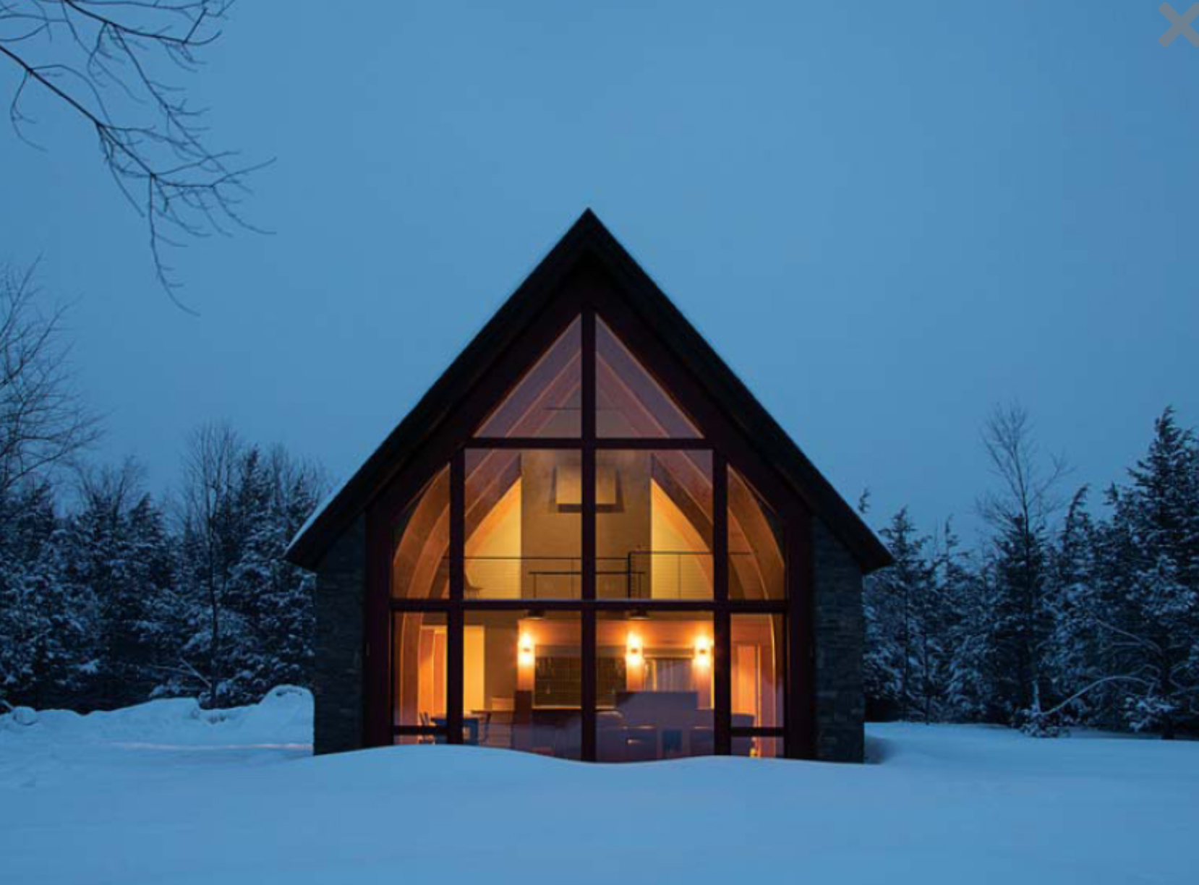
Links and resources:
https://unityhomes.com/
https://bensonwood.com/passive-house/
https://ecocor.us/
EcoCore Panelized Passive House Process:
https://www.youtube.com/watch?v=14QkzvmV6M0
Contact us at: dburke.yoga@gmail.com

